Slide 1

MGMT 59000 AUD Craigslist Consulting Project
Team –
NLP Therapy

Slide 2





Team NLP Therapy -
Subhashree Chowdhury
Manideep Sharma
Nalin Singh
Suyash Sukthankar
Lakshay Vohra

Slide 3

Background
Craigslist is an American classified advertisements website with plethora of sale, purchase and service-oriented advertisements.
The platform is highly advertiser oriented, which provides a simple, low-structure interface where advertisers can create their ads within minutes and with few constraints.
However, this results in a poor advertisement presentation for the potentials buyer which makes her/ him to scroll through many irrelevant advertisements in order to look for something they require.

Slide 4
Business Problem
The furniture advertisements in Craigslist is one of the popular category in the ‘For Sale’ section.
When people, especially students, move or relocate, they often face problems with finding furniture or easily accessible stores to shop from.
The furniture section in Craigslist presents an ambiguity while parsing through different ads it shows a mixture of advertisements of relevant and irrelevant furniture advertisements making it difficult for an individual as the advertisements cannot be filtered by their tags.

Slide 5
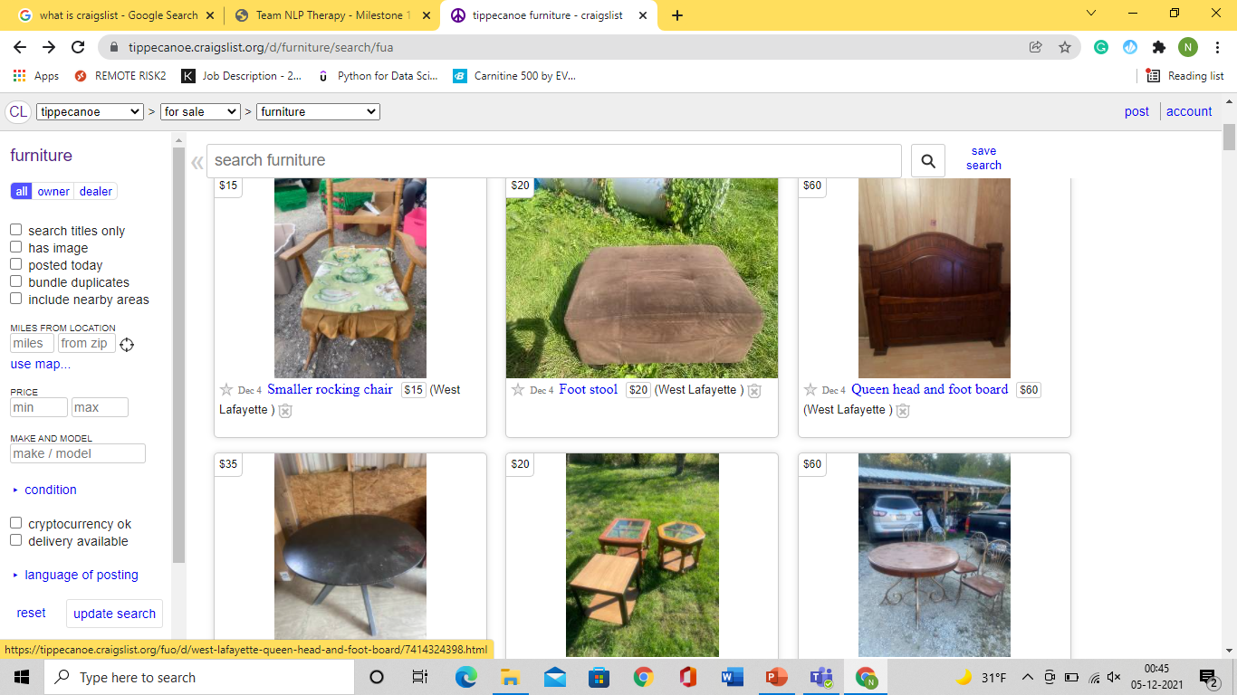
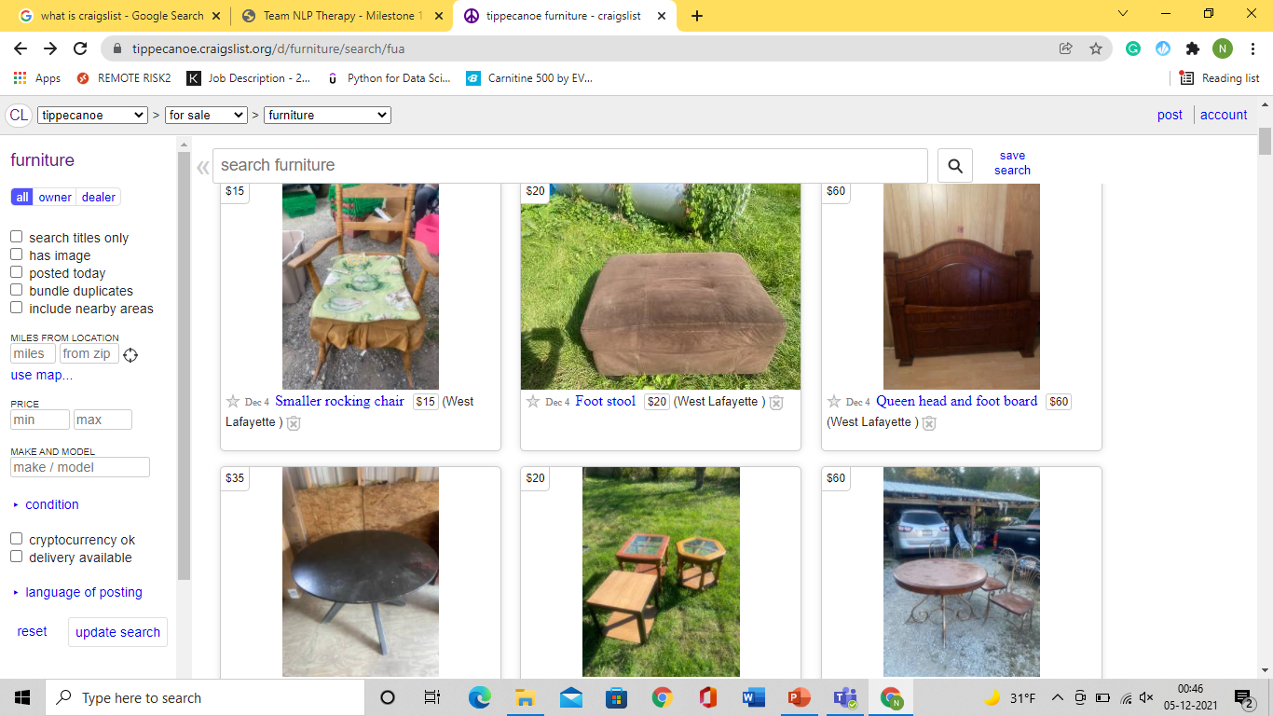
There are no tags or filtration that can be applied to find specific items of choice.

Slide 6
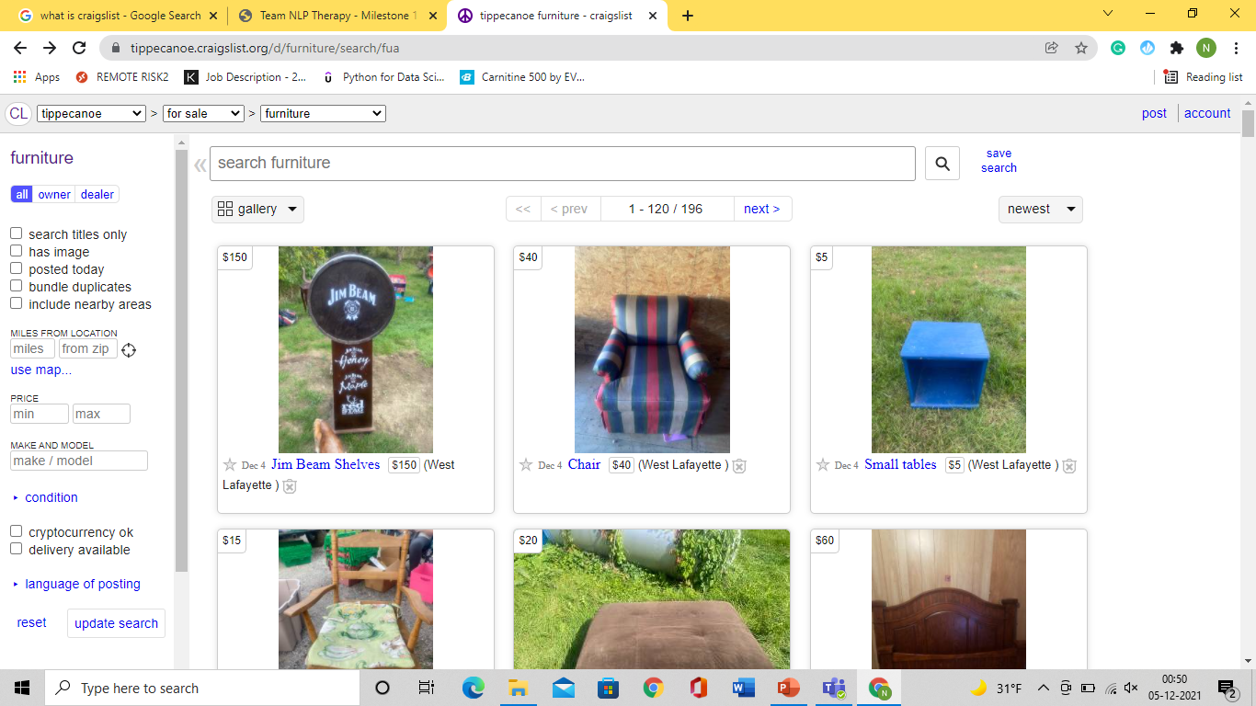
Current State of advertisement
3 tier classification system :
Cons:
Confusing and irrelevant results at times
Inability to refine searches
Not at par with competitors
Location
Example: NYC
Category
Example: For sale
Subcategory
Examples: Furniture, Appliances, Electronics

Slide 7
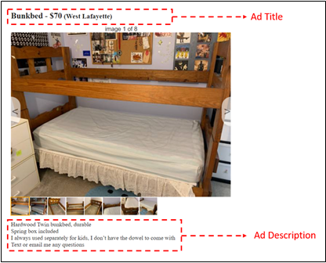
Our remedial plan
Embedding tags and running a prediction model to auto generate tags for advertisements which will act as filters for refined search results
Tags on most sought-after items like table, chair, bed, sofa, and rest are categorized as others.
No effect on advertiser experience
Categories will be relevant to furniture advertisements

Slide 8
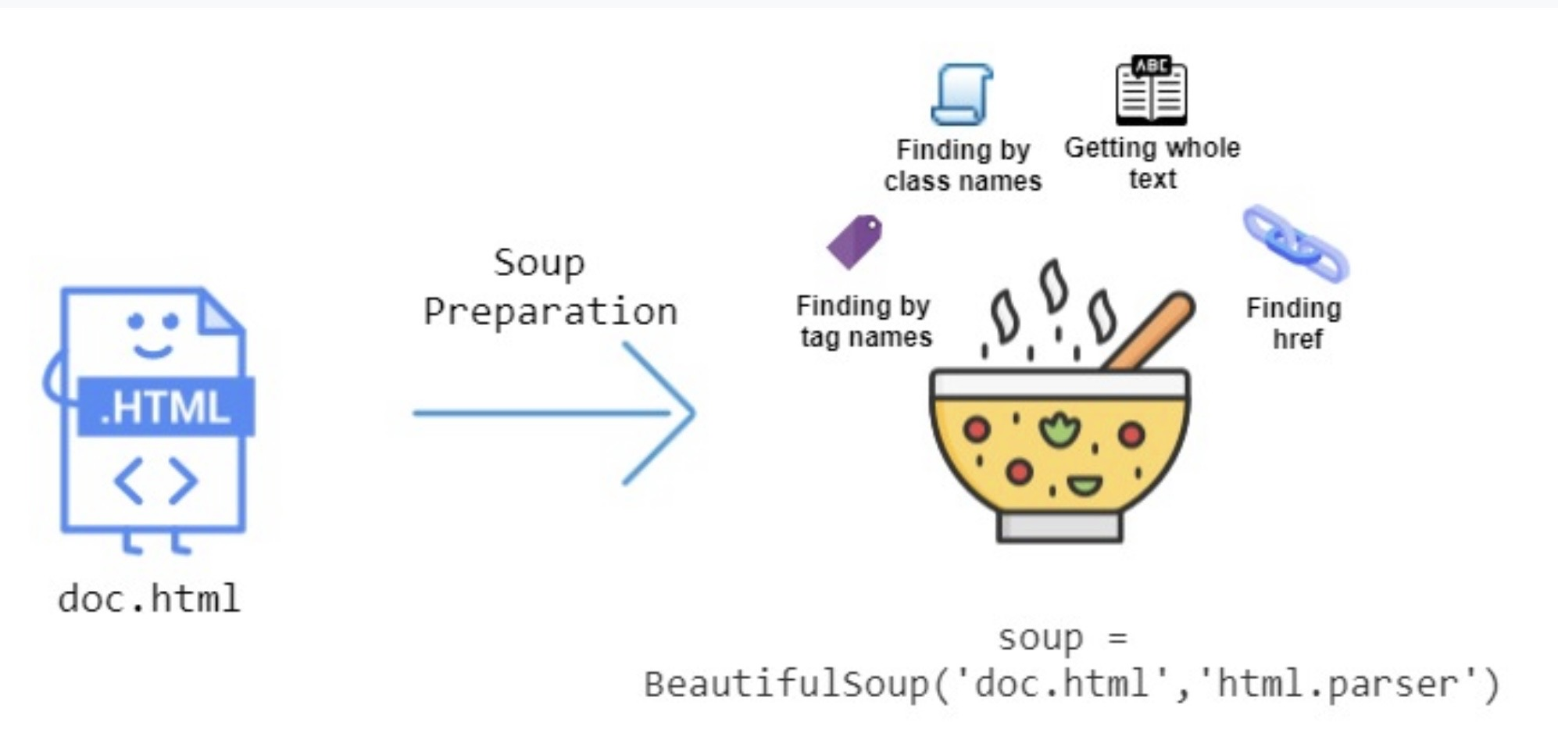
Data Analysis
Data Acquisition
Data Cleaning
1
2
White space
Lemmatization
Stop Words
N-grams
Vectorization

Slide 9
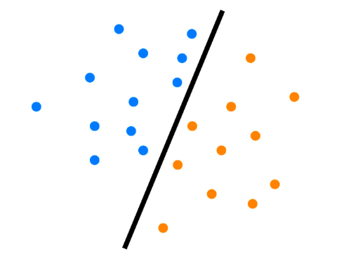
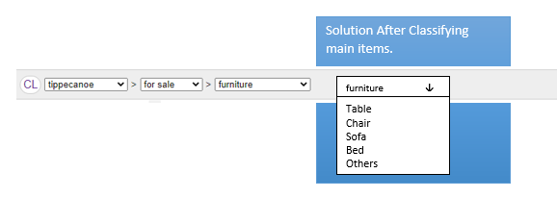
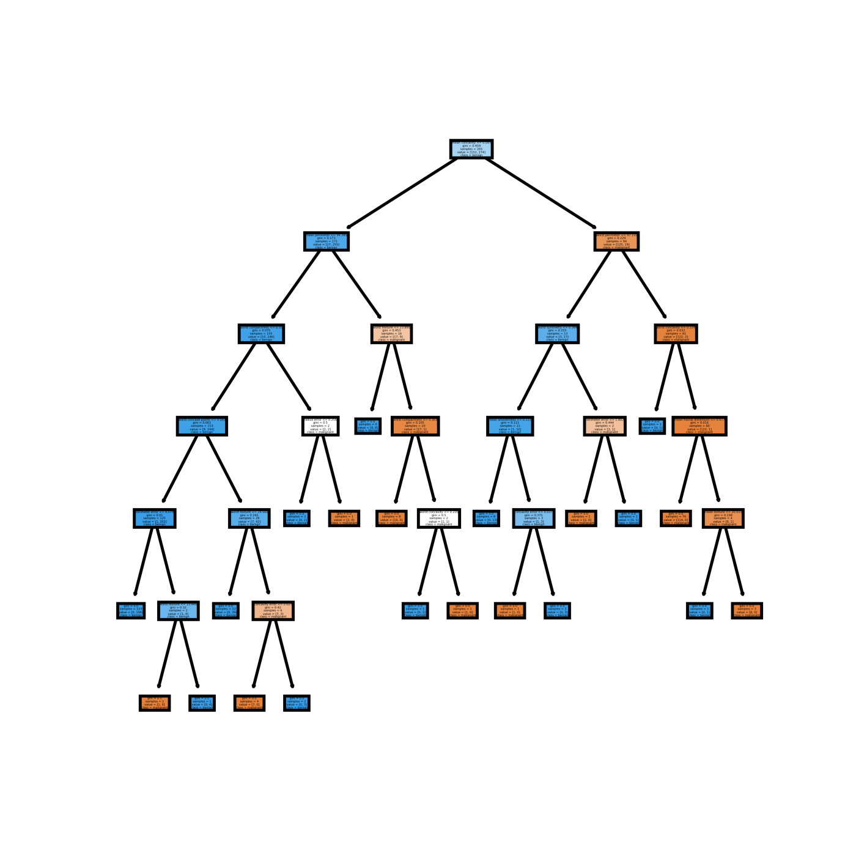
Data Analysis
Topics to Categories
Classification
Implementation
4
5
6
T1
1
2
3
4
…
T2
1
2
3
4
…
T3
1
2
3
4
…
T4
1
2
3
4
…
T5
1
2
3
4
…
T6
1
2
3
4
…

Slide 10
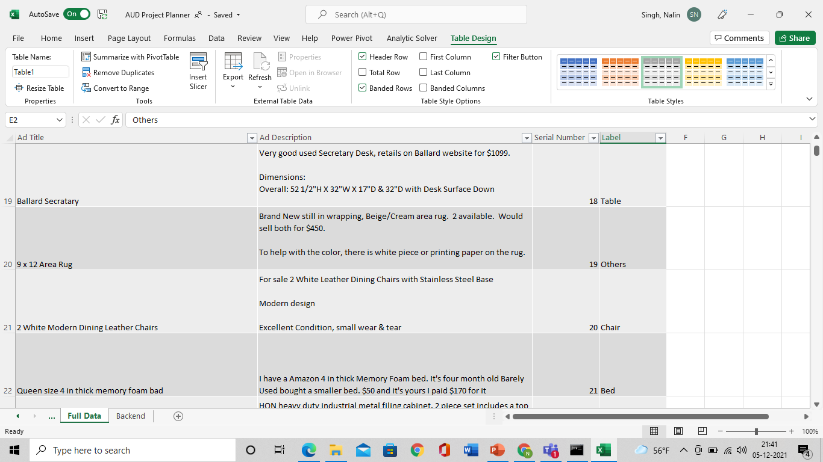

Classification Process
Scraped Advertisement Title and Description
Adding tags manually to create training data for prediction model

Slide 11
Validation
 | Test Score
SVM | 82.77%
Random Forest | 81.23%
Logistic Regression | 76.6%
Neural Network | 75.32%
Naïve Bayes | 65.29%
Naïve Bayes
Random Forest
SVM
Neural Network
Logistic Regression

Slide 12
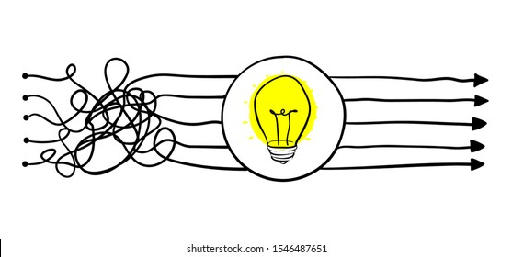
Value add for Business
Auto-Tagging of advertisements for filtering ads.
No change in advertiser experience
Comprehensive search for buyer
Improved Buyer Experience

Slide 13





Conclusion and Future Scope
Simple algorithm provides easy classification to improve user experience
Some manual intervention required in training the model
Room for improvement in more advertising categories

Slide 14
Thank you
Any questions?
Notes:
Esha

Slide 15
Appendix
Notes:
Esha

Slide 16
Most of the labeled ads are Tables or Chairs

